Slide 1
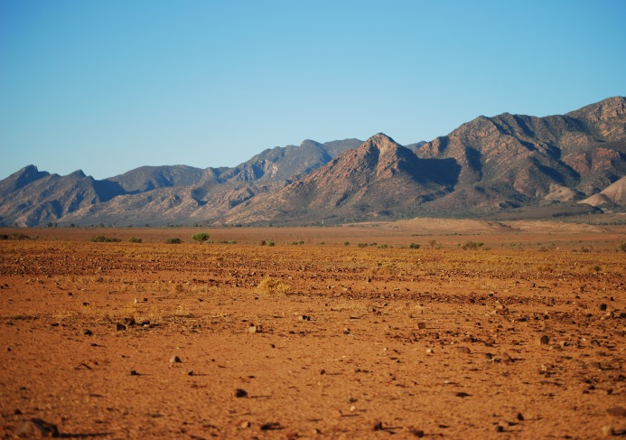
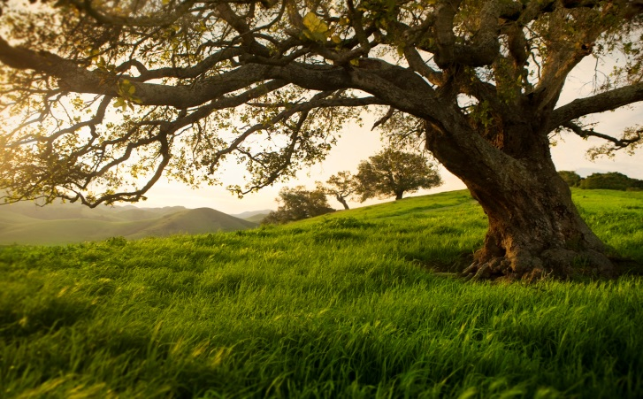
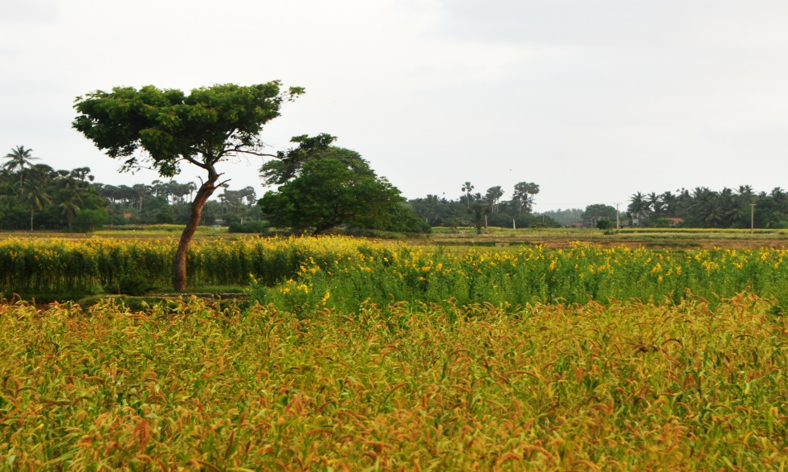
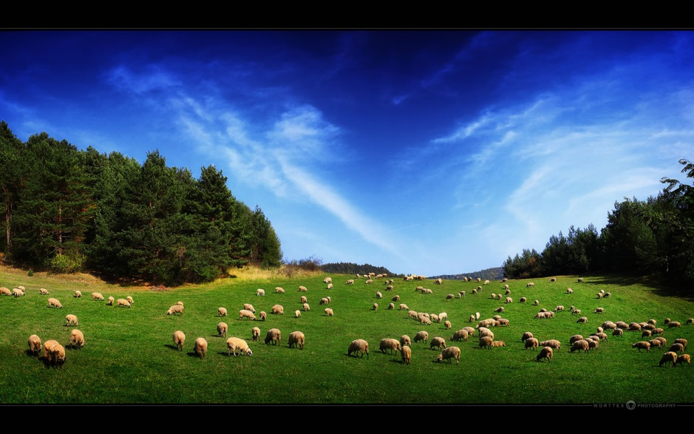
LAND ENVIRONMENTS

Slide 2
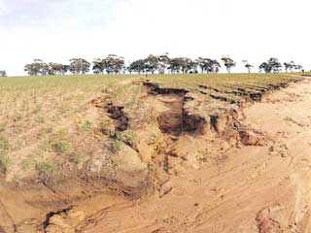
LAND DEGRADATION
What is ‘land degradation’?
Land degradation – the deterioration of land, including its vegetation, topsoil and water resources.

Slide 3
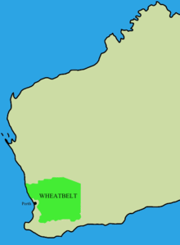
LAND DEGRADATION
The largest land degradation issues or challenge in Australia are related to the overgrazing in pastoral areas and the salinisation of agricultural soils in the W______________.

Slide 4
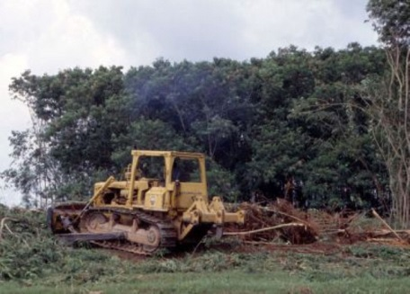
LAND DEGRADATION
Population in these areas, e.g. the Wheat belt – shrinking populations, amongst the least populated in the World.
So what has happened? Possible issues – over-clearing, over-stocking of the land with grazing animals.
Problem not caused by – excessive populations

Slide 5
Land and soil degradation
Land degradation – the decline in the quality of natural land resources, commonly caused by improper use. It includes soil degradation
It includes the adverse effects of overgrazing, excessive tillage, erosion, sediment deposition, mining, urbanisation, disposal of industrial wastes, road construction, decline of plant communities and the effects of noxious plants and animals.
Desertification is a significant impact of soil degradation.

Slide 6
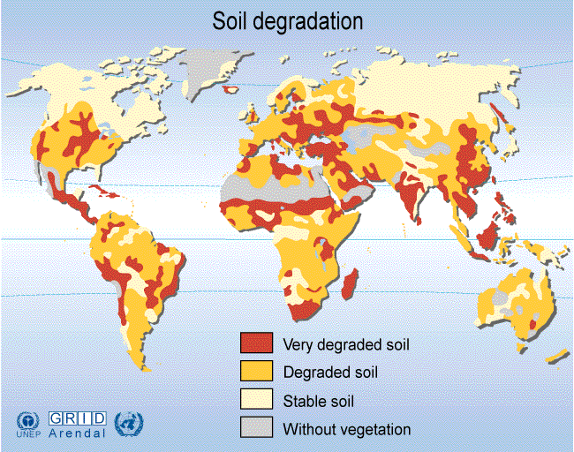

Slide 7
Land Degradation
Decline in the quality of the land.
One of the greatest 21st century human-induced changes (a_____________) that challenges s__________________.
Land degradation affects approximately 1.5 billion people.

Slide 8
CAUSES OF LAND DEGRADATION
Brainstorm examples as a class

Slide 9
CAUSES OF LAND DEGRADATION

Slide 10
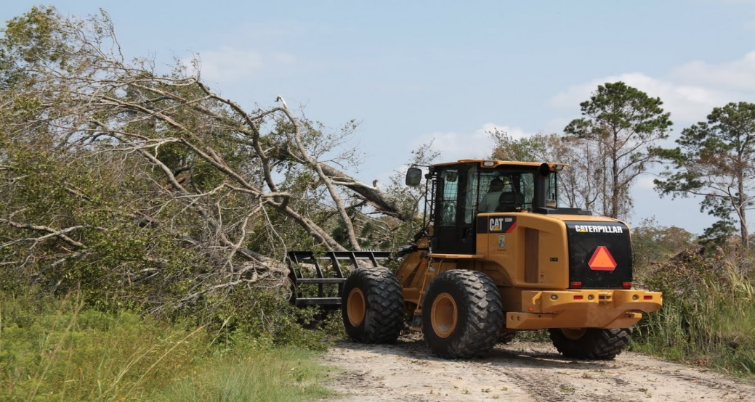
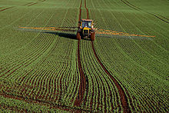
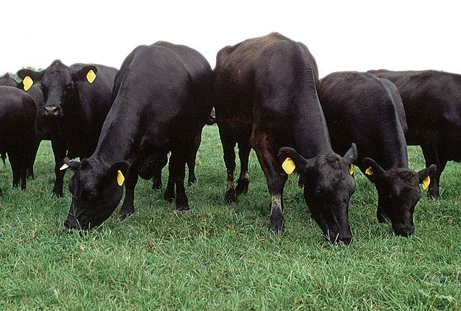
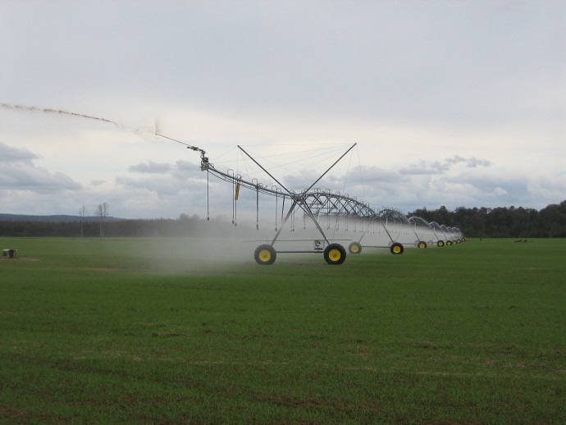
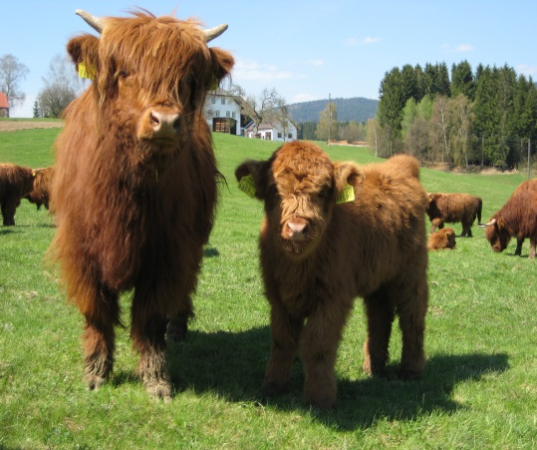
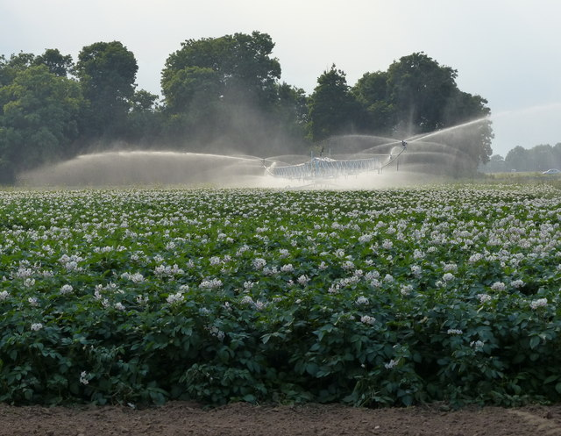
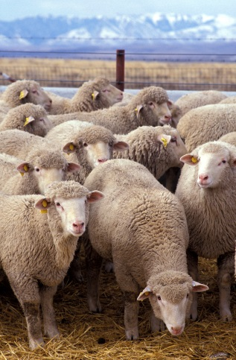
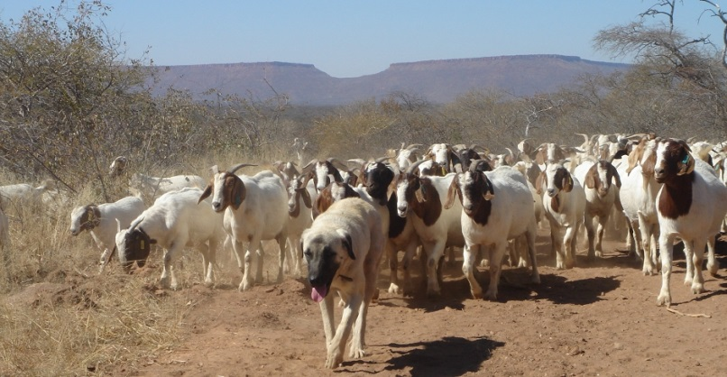

Slide 11
Impacts – Land Degradation
Brainstorm as a class

Slide 12
Impacts – Land Degradation

Slide 13
